Slide 1

Project Presentation
Topic: AI Powered Resume Analyzer
Presented By:
Aniruddha Adak - 27600122030
Krishanu Banerjee - 27600122136
Sayan Chakraborty - 27600122180
Soni Kumari - 27600122150
Supervisor: Mrs. Nivedita Das
Department of Computer Science and Engineering
Budge Budge Institute of Technology, Kolkata
March, 2026
PAGE 1

Slide 2
OBJECTIVE:
Primary Goal: To bridge the gap between job seekers and their dream roles using generative AI.
Improve Resume Quality: Generate actionable suggestions to enhance resume structure, keywords, formatting, and relevance for better job matching and ATS compatibility.
Provide Personalized Career Guidance: Offer tailored career recommendations, including suitable job roles, skill improvements, and learning paths based on the user's resume.
PAGE 2

Slide 3
ABSTRACT:
Platform Overview: A full-stack web application combining a responsive Next.js frontend and backend.
LLM/AI : Unlike Uses Gemini and ai for the resume analysis and voice transformation into text, so that user can communicate/chat through any language.
User Experience: Features a secure dashboard, optimization section and tracking section.
Impact: The project aims to reduce the rate of rejections of a job candidate in a job interview for an unstructured resume or absence of specific skills.
PAGE 3

Slide 4
TECH STACKS:
Frontend:
Backend :
Database and Authentication:
Framework: Next.js 16, React 19
Styling: Tailwind CSS V4
Language: Typescript
Primary Framework: Next.js Server Side
API Services : Gemini api services and servam ai
Database: PostgreSQL (vis Prisma ORM)
Auth-Middleware : Clerk
PAGE 5

Slide 5
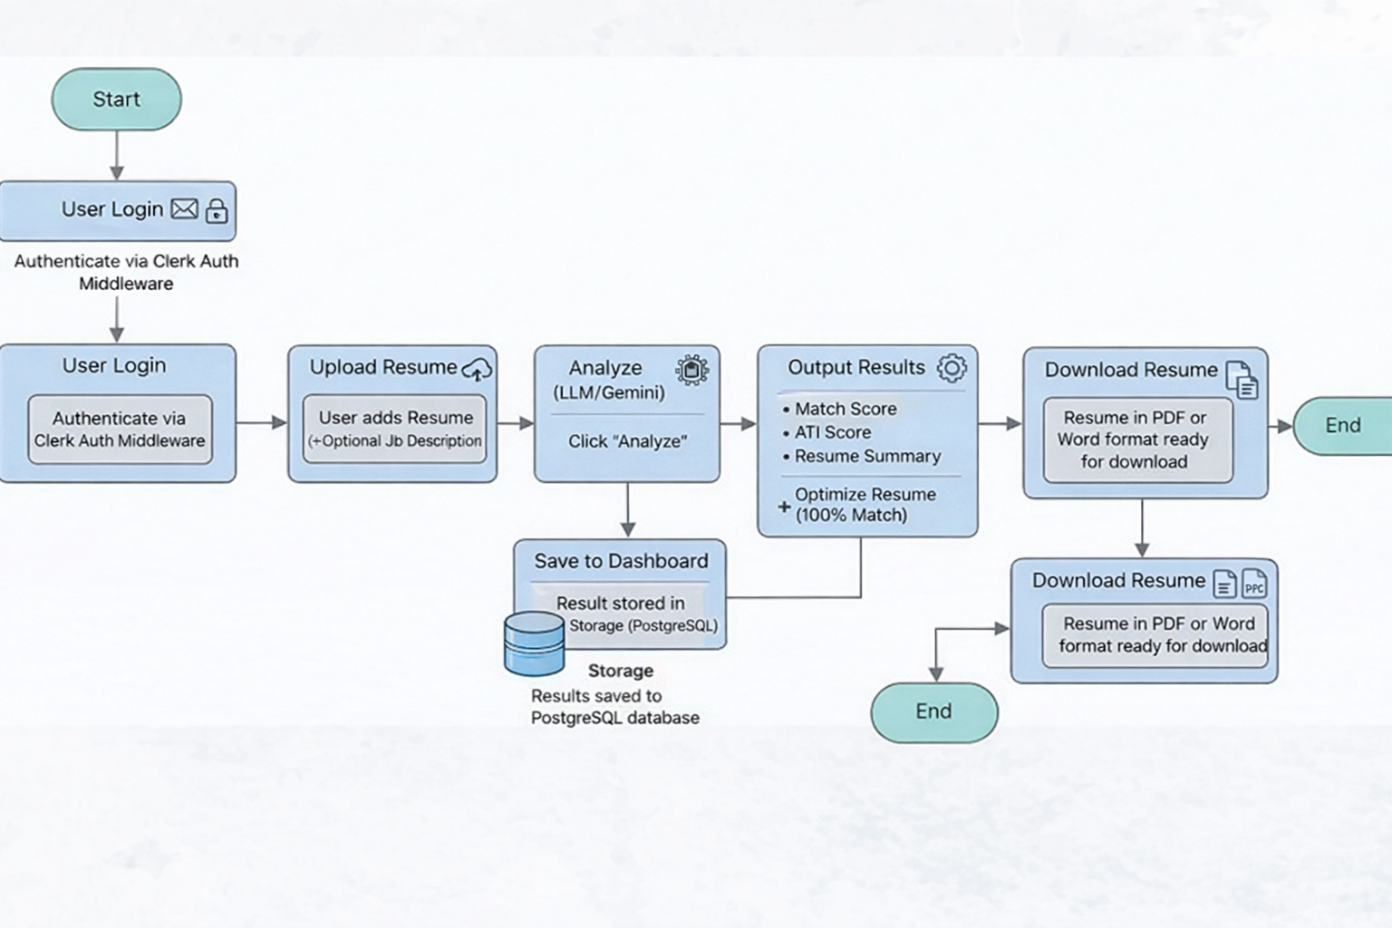
PROPOSED APPROACH:
Web Architecture: We propose a modern full-stack architecture utilizing Next.js for the responsive frontend and server-side rendering, integrated with Clerk Authentication for secure user login and session management. The system enables users to upload resumes and optionally provide job descriptions, ensuring a seamless and secure user experience..
AI-Driven Resume Analysis: Unlike traditional resume screening systems, our approach leverages Large Language Models (LLMs) such as Google Gemini to intelligently analyze resumes. The model evaluates the resume against the job description and generates key insights including Match Score, ATS Compatibility Score, and a structured resume summary, enabling users to understand how well their profile aligns with the job requirements.
Resume Optimization Engine: To improve hiring success rates, the system provides an AI-powered optimization feature that suggests modifications to increase resume relevance.
PAGE 6

Slide 6
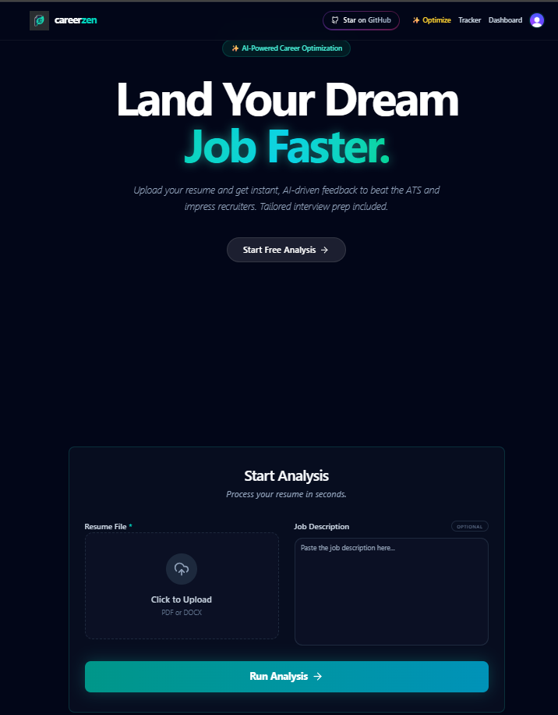
OVERVIEW OF USER INTERFACE:
PAGE 9

Slide 7
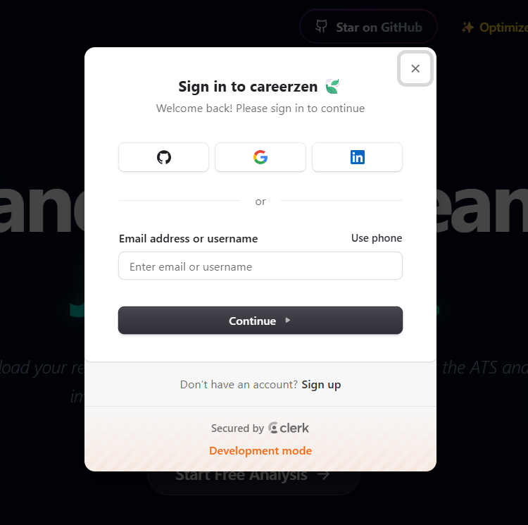
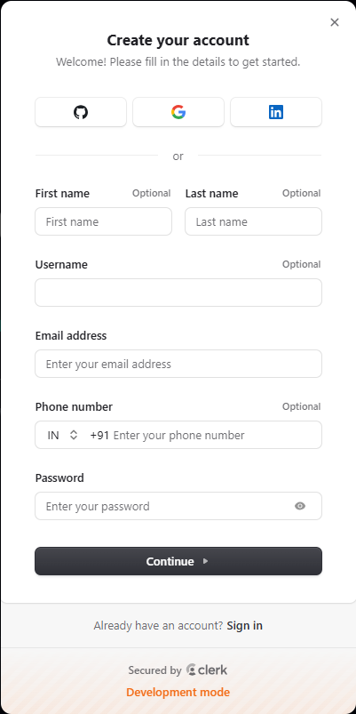
OVERVIEW OF AUTH FORMS:
PAGE 10

Slide 8
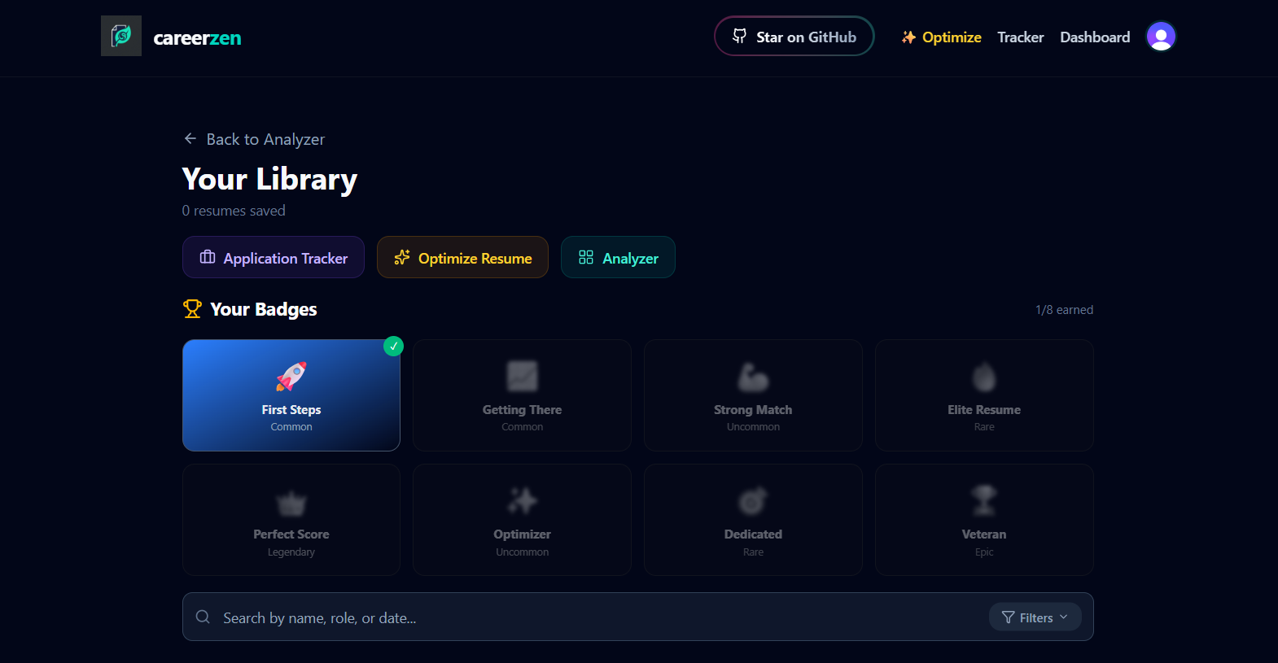
OVERVIEW OF DASHBOARD:
PAGE 11

Slide 9
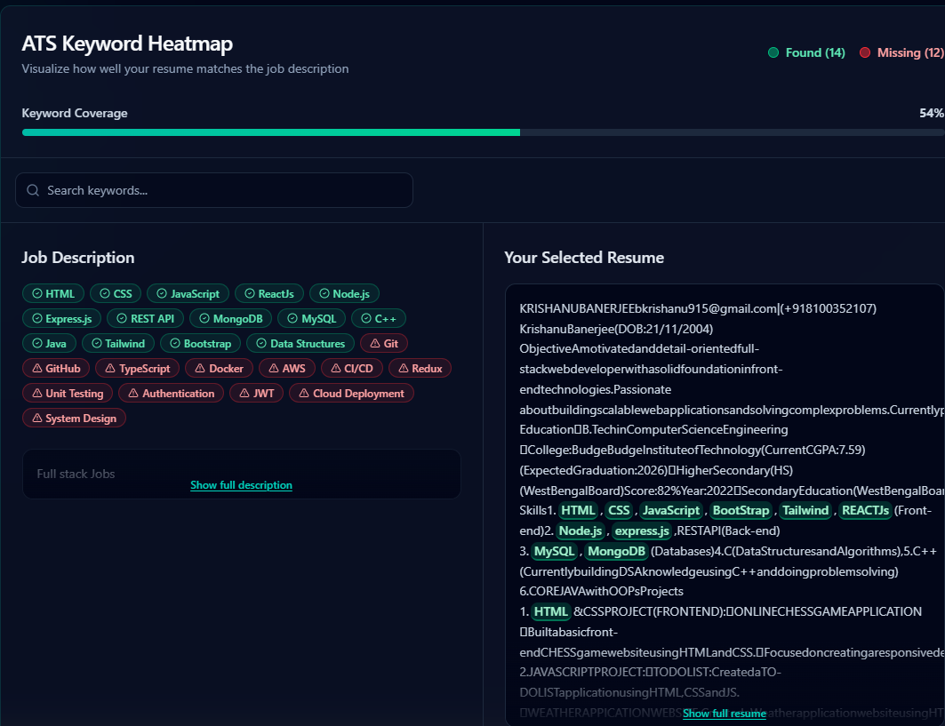
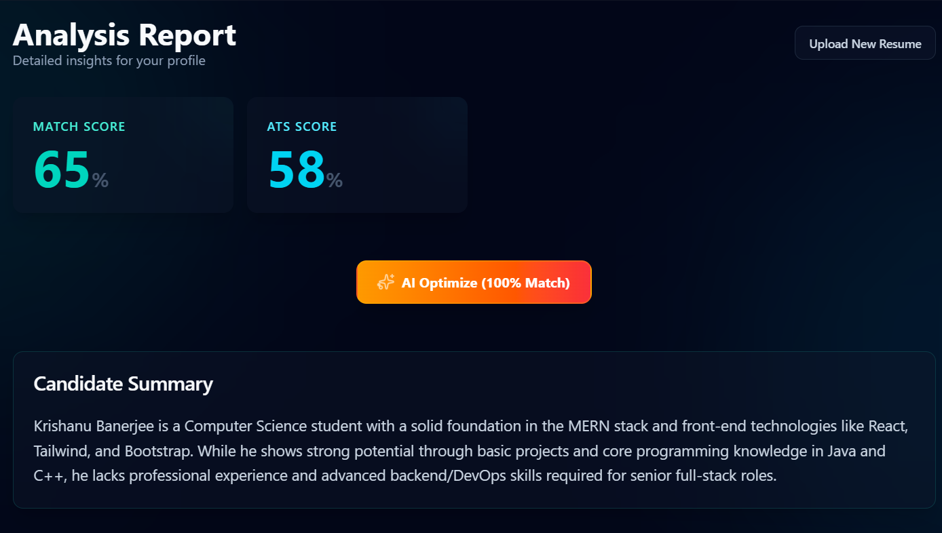
OVERVIEW OF ANALYSIS :
PAGE 12

Slide 10
FUTURE WORK:
Tracking: We are thinking to build a tracker where user can Track his job applications from wishlist to offer.
Job Suggestions: It will suggest companies to the applicant that he/she can apply according to his role.
LinkedIn Connection: This feature adds a Connect with LinkedIn option on the Optimizer page. Users authorize read-only access to their LinkedIn profile, and the platform automatically imports their headline, work experience, education, and skills directly into the optimizer inputs with no typing required.The user can review and edit the imported data before running the optimizer, ensuring complete control over what gets optimized. The LinkedIn token is stored securely on the server and never exposed in the browser.
Improving Accuracy: Trying out some more advanced LLMs to improve the accuracy of the application.
PAGE 15

Slide 11
CONCLUSION:
Bridging The Gap: The project successfully analyze and fill the gap between the candidate’s skillsets and the required skillsets in the production.
Guidance: By this application a job candidate surely can get a guidance for imporving his skillsets as recomended.
PAGE 16

Slide 12
REFERENCES:
https://nextjs.org/
https://www.typescriptlang.org/
https://tailwindcss.com/
https://www.sarvam.ai/
gemini
PAGE 17

Slide 13

PAGE 13

